Slide 1
Additional file 3: the original WB figures of Fig.4
For every blot, we first blot the membrane with antibodies to detect the levels of Tau phosphorylation, IBa1, GFAP or NeuN, and expose the membranes of AD and WT group together(list at the left of each page of PPT). Then cut the membranes containing the 25KD and 37KD markers to confirm the level of GAPDH (list at the right of each pages of PPT).

Slide 2
Figure 4A
RAB fraction： pTau(S202/T205) (blot with AT8 antibody)
RAB fraction：GAPDH
P301S Male
P301S Female
P301S Male
P301S Female
3M
6M
9M
12M
3M
6M
9M
12M
3M
6M
9M
12M
3M
6M
9M
12M
75kD
50kD
37kD
3M
6M
9M
12M
3M
6M
9M
12M
WT Male
WT Female
75kD
50kD
37kD
3M
6M
9M
12M
3M
6M
9M
12M
WT Male
WT Female

Slide 3
Figure 4B
RIPA fraction： pTau(S202/T205)
RIPA fraction：GAPDH
P301S Male
P301S Female
P301S Male
P301S Female
3M
6M
9M
12M
3M
6M
9M
12M
3M
6M
9M
12M
3M
6M
9M
12M
75kD
50kD
37kD
25kD
3M
6M
9M
12M
3M
6M
9M
12M
WT Male
WT Female
20kD
75kD
50kD
37kD
25kD
20kD
3M
6M
9M
12M
3M
6M
9M
12M
WT Male
WT Female

Slide 4
Figure 4C
Urea fraction：pTau(S202/T205)
P301S Male
P301S Female
3M
6M
9M
12M
3M
6M
9M
12M
75kD
50kD
37kD
25kD
75kD
50kD
37kD
25kD
3M
6M
9M
12M
3M
6M
9M
12M
WT Male
WT Female

Slide 5
Figure 4D
RAB fraction： pTau(S396) (blot with PHF 13 antibody)
RAB fraction： GAPDH
P301S Male
P01S Female
P301S Male
P301S Female
3M
6M
9M
12M
3M
6M
9M
12M
3M
6M
9M
12M
3M
6M
9M
12M
37kD
75kD
50kD
37kD
37kD
3M
6M
9M
12M
3M
6M
9M
12M
25kD
WT Male
WT Female
75kD
50kD
37kD
25kD
3M
6M
9M
12M
3M
6M
9M
12M
WT Male
WT Female

Slide 6
Figure 4E
RIPA fraction： pTau(S396) (PHF 13)
RIPA fraction：GAPDH
P301S Male
P301S Female
P301S Male
P301S Female
3M
6M
9M
12M
3M
6M
9M
12M
3M
6M
9M
12M
3M
6M
9M
12M
75kD
50kD
37kD
25kD
WT Male
WT Female
3M
6M
9M
12M
3M
6M
9M
12M
20kD
75kD
50kD
37kD
25kD
20kD
3M
6M
9M
12M
3M
6M
9M
12M
WT Male
WT Female

Slide 7
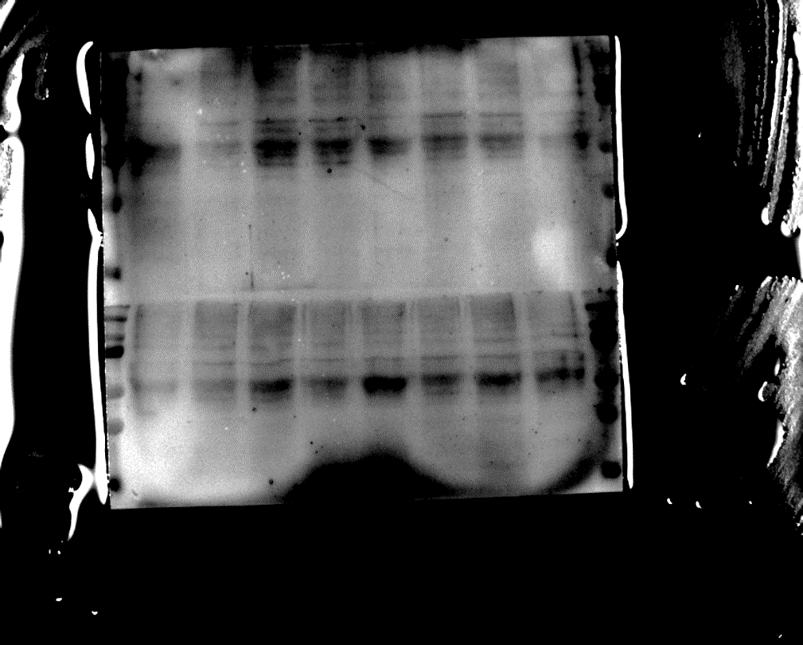
Figure 4F
Urea fraction：pTau(S396)
P301S Male
P301S Female
3M
6M
9M
12M
3M
6M
9M
12M
75kD
50kD
37kD
25kD
75kD
50kD
37kD
25kD
3M
6M
9M
12M
3M
6M
9M
12M
WT Male
WT Female

Slide 8
Figure 4G
RAB fraction： pTau(S404)
RAB fraction： GAPDH
P301S Male
P301S Female
P301S Male
P301S Female
3M
6M
9M
12M
3M
6M
9M
12M
3M
6M
9M
12M
3M
6M
9M
12M
37kD
75kD
50kD
37kD
37kD
3M
6M
9M
12M
3M
6M
9M
12M
25kD
WT Male
WT Female
75kD
50kD
37kD
25kD
3M
6M
9M
12M
3M
6M
9M
12M
WT Male
WT Female

Slide 9
Figure 4H
RIPA fraction： pTau(S404)
RIPA fraction： GAPDH
P301S Male
P301S Female
P301S Male
P301S Female
3M
6M
9M
12M
3M
6M
9M
12M
3M
6M
9M
12M
3M
6M
9M
12M
75kD
37kD
50kD
37kD
37kD
25kD
3M
6M
9M
12M
3M
6M
9M
12M
WT Male
WT Female
20kD
75kD
50kD
37kD
25kD
20kD
3M
6M
9M
12M
3M
6M
9M
12M
WT Male
WT Female

Slide 10
Figure 4I
Urea fraction：pTau(S404)
P301S Male
P301S Female
3M
6M
9M
12M
3M
6M
9M
12M
75kD
50kD
37kD
25kD
75kD
50kD
37kD
25kD
3M
6M
9M
12M
3M
6M
9M
12M
WT Male
WT Female

Slide 11
Figure 4J
RAB fraction：Human Tau (blot with HT7 antibody)
RAB fraction：GAPDH
P301S Male
P301S Female
P301S Male
P301S Female
3M
6M
9M
12M
3M
6M
9M
12M
3M
6M
9M
12M
3M
6M
9M
12M
37kD
75kD
50kD
37kD
37kD
25kD
3M
6M
9M
12M
3M
6M
9M
12M
20kD
WT Male
WT Female
WT Male
WT Female
3M
6M
9M
12M
3M
6M
9M
12M
75kD
50kD
37kD
25kD
20kD

Slide 12
Figure 4K
RIPA fraction： Human Tau (HT7)
RIPA fraction：GAPDH
WT Male
WT Female
WT Male
WT Female
3M
6M
9M
12M
3M
6M
9M
12M
3M
6M
9M
12M
3M
6M
9M
12M
75kD
37kD
50kD
25kD
37kD
37kD
25kD
3M
6M
9M
12M
3M
6M
9M
12M
P301S Male
P301S Female
75kD
50kD
37kD
25kD
3M
6M
9M
12M
3M
6M
9M
12M
P301S Male
P301S Female

Slide 13
Figure 4L
Urea fraction： Human Tau (HT7)
P301S Male
P301S Female
3M
6M
9M
12M
3M
6M
9M
12M
75kD
50kD
37kD
75kD
50kD
37kD
25kD
3M
6M
9M
12M
3M
6M
9M
12M
WT Male
WT Female

Slide 14
Figure 4M
RAB fraction： Iba1(blot with EPR16588 antibody)
RAB fraction： GAPDH
P301S Male
P301S Female
P301S Male
P301S Female
3M
6M
9M
12M
3M
6M
9M
12M
3M
6M
9M
12M
3M
6M
9M
12M
25kD
37kD
20kD
15kD
37kD
25kD
3M
6M
9M
12M
3M
6M
9M
12M
20kD
WT Male
WT Female
15kD
3M
6M
9M
12M
3M
6M
9M
12M
WT Male
WT Female

Slide 15
Figure 4N
RAB fraction： GFAP (blot with 2E1.E9 antibody)
RAB fraction： GAPDH
P301S Male
P301S Female
P301S Male
P301S Female
3M
6M
9M
12M
3M
6M
9M
12M
3M
6M
9M
12M
3M
6M
9M
12M
37kD
75kD
37kD
50kD
37kD
25kD
3M
6M
9M
12M
3M
6M
9M
12M
WT Male
WT Female
75kD
50kD
37kD
25kD
3M
6M
9M
12M
3M
6M
9M
12M
WT Male
WT Female

Slide 16
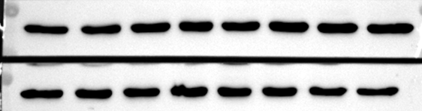
Figure 4O
RAB fraction： NeuN (blot with 1B7 antibody)
RAB fraction： GAPDH
P301S Male
P301S Female
AP301S Male
P301S Female
3M
6M
9M
12M
3M
6M
9M
12M
3M
6M
9M
12M
3M
6M
9M
12M
37kD
75kD
50kD
37kD
37kD
3M
6M
9M
12M
3M
6M
9M
12M
WT Male
WT Female
75kD
50kD
37kD
3M
6M
9M
12M
3M
6M
9M
12M
WT Male
WT Female

